Slide 1

SCALA

Slide 2
Contents
Functions
Pure and Impure Functions
Higher Order Functions
Exception Handling
Error Handling with Try
Pattern Matching

Slide 3
Functions
A function is a group of statements that perform a task.
You can divide up your code into separate functions. How you divide up your code among different functions is up to you, but logically, the division usually is so that each function performs a specific task.
Scala has both functions and methods and we use the terms method and function interchangeably with a minor difference.

Slide 4
A Scala method is a part of a class which has a name, a signature, optionally some annotations, and some bytecode where as a function in Scala is a complete object which can be assigned to a variable.
In other words, a function, which is defined as a member of some object, is called a method.
A function definition can appear anywhere in a source file and Scala permits nested function definitions, that is, function definitions inside other function definitions.
Most important point to note is that Scala function's name can have characters like +, ++, ~, &,-, --, \, /, :, etc.

Slide 5
Function Declarations
A Scala function declaration has the following form −
Methods are implicitly declared abstract if you don’t use the equals sign and the method body.

Slide 6
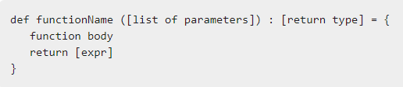
Function Definitions
A Scala function definition has the following form −
Syntax

Slide 7
Here, return type could be any valid Scala data type and list of parameters will be a list of variables separated by comma and list of parameters and return type are optional.
Very similar to Java, a return statement can be used along with an expression in case function returns a value.
Following is the function which will add two integers and return their sum −

Slide 8
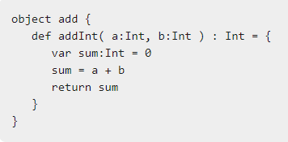
Syntax
A function, that does not return anything can return a Unit that is equivalent to void in Java and indicates that function does not return anything.
The functions which do not return anything in Scala, they are called procedures.

Slide 9
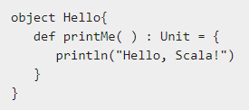
Syntax
Here is the syntax −

Slide 10
Pure and Impure Functions
In any programming language, there are two types of functions:
1. PURE FUNCTIONS
2. IMPURE FUNCTIONS
There is a basic difference between the two, that is pure function doesn’t change the variable it’s passed and an impure function does.

Slide 11
For example, there exists a function which increases the input by 10.
So, there are two possibilities, the first one is it could directly return x + 10 and so x does not change whereas in another case it could go with the statement like x = x + 10 and then return x, thus changing the value of x.
So, the first function is pure whereas the other is impure.

Slide 12
Pure Function in scala
A function is called pure function if it always returns the same result for same argument values and it has no side effects like modifying an argument (or global variable) or outputting something.
They are those functions which don’t read any other values except those given as input and follows its internal algorithm to produce the output. A pure function is side-effect free i.e it doesn’t change the value of the variable implicitly and thus doesn’t end up altering the values of the input.

Slide 13
These Scala String methods are also pure functions:
isEmpty
Length
substring

Slide 14
Benefits Of using Pure Functions:
They don’t cause any implicitly changes in input.
They are easier to test.
They can be debug easily.

Slide 15
Impure functions
An impure function is a function that mutates variables/state/data outside of it’s lexical scope, thus deeming it “impure” for this reason.
There are many ways to write JavaScript, and thinking in terms of impure/pure functions we can write code that is much easier to reason with.

Slide 16
Higher Order Functions
Scala allows the definition of higher-order functions. These are functions that take other functions as parameters, or whose result is a function.
Try the following example program, apply() function takes another function f and a value v and applies function f to v.

Slide 17
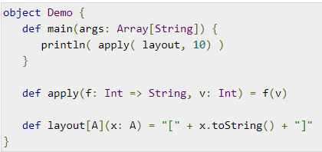
Example
Save the above program in Demo.scala.
The following commands are used to compile and execute this program.

Slide 18


Command
Output

Slide 19
Exception Handling
An exception is an event that changes the normal flow of a program.
Exception handling is the mechanism to respond to the occurrence of an exception.
Exceptions can be checked or unchecked.
Scala only allows unchecked exceptions, though.
This means that, at compile-time, we won’t be able to know if a method is throwing an exception we are not handling.

Slide 20
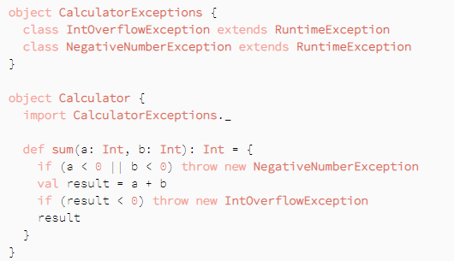
Let’s write a simple calculator to show different ways of handling exceptions in Scala. It’ll only add positive integer numbers:

Slide 21
Our method could throw a NegativeNumberException if one of the addends is negative, or IntOverflowException if the sum overflows the Int range.
When using our calculator, we’ll have to consider how to handle those exceptions.

Slide 22
Error Handling with Try
Because functional programming is like algebra, there are no null values or exceptions.
But of course you can still have exceptions when you try to access servers that are down or files that are missing.
Try makes it very simple to catch exceptions

Slide 23


Here’s the toInt method re-written to use these classes. First, import the classes into the current scope:
After that, this is what toInt looks like with Try:

Slide 24


As you can see, that’s quite a bit shorter than the Option/Some/None approach, and it can further be shortened to this:
Both of those approaches are much shorter than the Option/Some/None approach.
The REPL demonstrates how this works. First, the success case:

Slide 25
Second, this is what it looks like when Integer.parseInt throws an exception:
As that output shows, the Failure that’s returned by toInt contains the reason for the failure, i.e., the exception.
There are quite a few ways to work with the results of a Try — including the ability to “recover” from the failure — but common approaches still involve using match and for expressions:

Slide 26
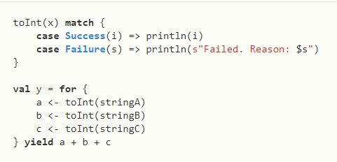

Note that when using a for-expression and everything works, it returns the value wrapped in a Success:

Slide 27
Conversely, if it fails, it returns a Failure:

Slide 28
Pattern Matching
Pattern matching is the second most widely used feature of Scala, after function values and closures.
Scala provides great support for pattern matching, in processing the messages.
A pattern match includes a sequence of alternatives, each starting with the keyword case. Each alternative includes a pattern and one or more expressions, which will be evaluated if the pattern matches.
An arrow symbol => separates the pattern from the expressions.

Slide 29
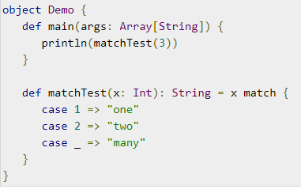
Try the following example program, which shows how to match against an integer value.
Example

Slide 30

Save the above program in Demo.scala. The following commands are used to compile and execute this program.
Command

Slide 31

Output
The block with the case statements defines a function, which maps integers to strings. The match keyword provides a convenient way of applying a function (like the pattern matching function above) to an object.
Try the following example program, which matches a value against patterns of different types.

Slide 32
THANK YOU

